Slide 1
Object-oriented Programming
Week 13 | Lecture 2

Slide 2
Output?
#include <iostream>
using namespace std;
double zeroDivision(int x, int y) {
return (x / y);}
int main() {
int numerator;
int denominator;
double result;
cout << "enter numerator and denominator: " << endl;
cin>>numerator>>denominator; // 3 and 0
result = zeroDivision(numerator, denominator);
cout << "result is " << result << endl;
cout <<"divide by zero" << endl << endl;
return 0;}

Slide 5
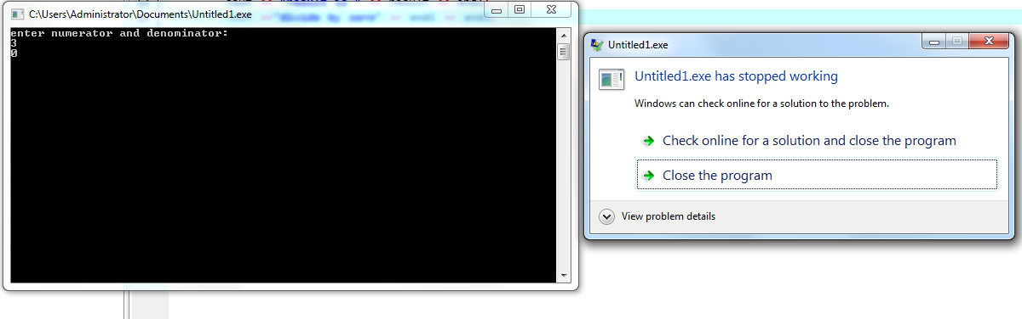
Output?

Slide 6
Exceptions
Exception handling in C++ provides you with a way of handling unexpected circumstances like runtime errors. So whenever an unexpected circumstance occurs, the program control is transferred to special functions known as handlers.
An exception is an abnormal condition that arises in a code sequence at run time
In other words, an exception is a run-time error

Slide 7
Handlers
Exceptions provide a way to transfer control from one part of a program to another. C++ exception handling is built upon three keywords:
try,
catch, and
throw.

Slide 8
Handlers
throw- when a program encounters a problem, it throws an exception. The throw keyword helps the program perform the throw.
catch- a program uses an exception handler to catch an exception. It is added to the section of a program where you need to handle the problem. It's done using the catch keyword.
try- the try block identifies the code block for which certain exceptions will be activated. It should be followed by one/more catch blocks.

Slide 9
Catching Exceptions
The catch block following the try block catches any exception. You can specify what type of exception you want to catch and this is determined by the exception declaration that appears in parentheses following the keyword catch.
try {
// protected code
} catch( ExceptionName exception1 ) {
// code to handle ExceptionName exception
}

Slide 10
Throwing Exceptions
Exceptions can be thrown anywhere within a code block using throw statement. The operand of the throw statement determines a type for the exception and can be any expression and the type of the result of the expression determines the type of exception thrown.
double division(int a, int b) {
if( b == 0 ) {
throw "Division by zero condition!"; //throw b;
}
return (a/b);
}

Slide 11
try
A block of code which may cause an exception is typically placed inside the try block. It’s followed by one or more catch blocks. If an exception occurs, it is thrown from the try block.
try {
// protected code
}

Slide 12
throw
Possible to declare throw keyword anywhere in the try block. throw keyword trigger/execute a matched type of the catch block.The try block exists When a throw statement is reached.

Slide 13
Catching Exceptions
The ExceptionName is the name of the exception to be caught.
The exception1 are your defined names for referring to the exceptions.

Slide 14
Example
#include <iostream>
using namespace std;
double zeroDivision(int x, int y) {
if (y == 0) {
throw y;}
return (x / y);}
int main() {
int numerator;
int denominator;
double result;
cout << "enter numerator and denominator: " << endl;
cin>>numerator>>denominator;
try {
result = zeroDivision(numerator, denominator);
cout << "result is " << result << endl; }
catch (int ex) {
cout <<"divide by zero" << endl << ex << endl; }
return 0;}

Slide 15
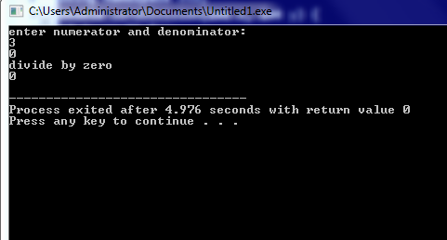
Example

Slide 16
#include <iostream>
using namespace std;
int main() {
double balance = 5000.0;
double withdraw;
cout << "Enter amount to withdraw: ";
cin >> withdraw;
try {
if (withdraw > balance)
throw "Insufficient Balance!";
balance -= withdraw;
cout << "Withdrawal successful. New balance: " << balance << endl; }
catch (const char* msg) {
cout << "Exception: " << msg << endl; }
return 0;
}

Slide 17
Exception Handling Checklist
Try block has the main code, which code may throw an exception.
Multiple throws are possible to declare in try block based different situations.
The catch block contains exception handling code that is executed when thrown by the Try Block.
Possible to declare one or more catch block for different type of exception
No code can be between try block and the first catch block.
Catch blocks declare directly after the try block.

Slide 18
flow of execution of try/catch blocks.
#include <iostream>
#include <exception>
using namespace std;
double zeroDivision(int x, int y) {
if (y == 0) {
throw y;
cout << "After throw (Never executed) \n";}
return (x / y);}
int main() {
int numerator;
int denominator;
double result;
cout << "enter numerator and denominator: " << endl;
cin>>numerator>>denominator;
cout << "Before try \n";

Slide 19
flow of execution of try/catch blocks.
try {
result = zeroDivision(numerator, denominator);
cout << "result is " << result << endl; }
catch (int e) {
cout <<"divide by zero" << endl; }
cout << "After catch (Will be executed) \n";
return 0;}

Slide 20
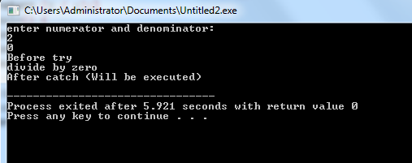
flow of execution of try/catch blocks.

Slide 21
Without catch
#include <iostream>
#include <exception>
using namespace std;
double zeroDivision(int x, int y) {
if (y == 0) {
throw y;}
return (x / y);}
int main() {
int numerator;
int denominator;
double result;
cout << "enter numerator and denominator: " << endl;
cin>>numerator>>denominator;
try {
result = zeroDivision(numerator, denominator);
cout << "result is " << result << endl; }
return 0;}

Slide 22

Without catch

Slide 23
Multiple catch Clauses
In some cases, more than one exception could be raised by a single piece of code
To handle this type of situation, you can specify two or more catch clauses, each catching a different type of exception
After one catch statement executes, the others are bypassed

Slide 24
Multiple catch Clauses
You can list down multiple catch statements to catch different type of exceptions in case your try block raises more than one exception in different situations.
try { // protected code }
catch( ExceptionName e1 )
{ // catch block }
catch( ExceptionName e2 ) { // catch block }
catch( ExceptionName eN ) { // catch block }

Slide 25
Multiple catch Clauses
#include <iostream>
#include <exception>
using namespace std;
double zeroDivision(int x, int y) {
if (y == 0) {
throw y;}
return (x / y);}
int main() {
int numerator;
int denominator;
double result;
cout << "enter numerator and denominator: " << endl;
cin>>numerator>>denominator;
try {
result = zeroDivision(numerator, denominator);
cout << "result is " << result << endl; }

Slide 26
Multiple catch Clauses
catch (int e) {
cout <<"divide by zero" << endl << e << endl; }
catch (int e) {
cout <<"another exception" << endl << e << endl; }
catch (int e) {
cout <<"another exception" << endl << e << endl; }
return 0;}

Slide 27
catch all block
If you want to specify that a catch block should handle any type of exception that is thrown in a try block, you must put an ellipsis, ..., between the parentheses enclosing the exception declaration as follows −
try { // protected code }
catch(...)
{ // code to handle any exception }

Slide 28
catch all block
#include <iostream>
using namespace std;
double zeroDivision(int x, int y) {
if (y == 0) {
throw y;}
return (x / y);}
int main() {
int numerator;
int denominator;
double result;
cout << "enter numerator and denominator: " << endl;
cin>>numerator>>denominator;
try {
result = zeroDivision(numerator, denominator);
cout << "result is " << result << endl; }
catch(...){
cout <<"divide by zero" << endl << endl; }
return 0;}

Slide 29
If an exception is thrown and not caught anywhere, the program terminates abnormally.
#include <iostream>
using namespace std;
int main(){
try {
throw 'a'; }
catch (int x) {
cout << "Caught "; }
return 0;}

Slide 30
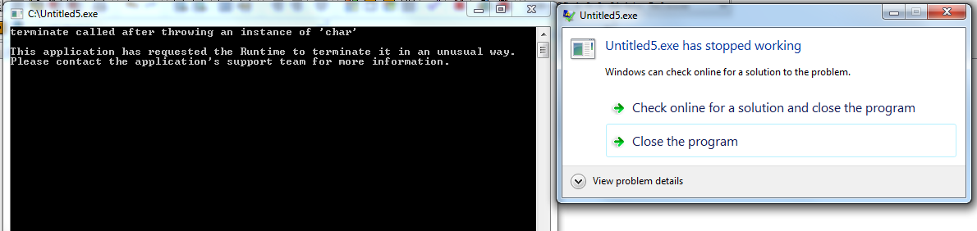
Implicit type conversion doesn’t happen for primitive types. For example, in the following program ‘a’ is not implicitly converted to int

Slide 31
Correct version
#include <iostream>
using namespace std;
int main()
{
try {
throw 'a';
}
catch (int x) {
cout << "Caught " << x;
}
catch (...) {
cout << "Default Exception\n";
}
return 0;
}

Slide 32
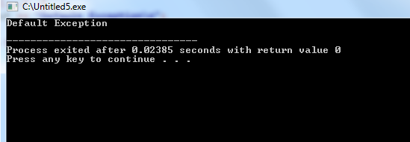
output

Slide 33
Purpose of rethrow;
Sometimes you want to:
Catch an exception temporarily,
Do something small (like logging, cleaning up),
Then throw it again so someone else can handle it further up the call stack.
Example: You log the error here, but the main function or some bigger handler should deal with it.
throw; is used to "pass forward" an already caught exception to
another catch higher up.

Slide 34
Simple C++ Program for Rethrowing Exception Handling in Function
void exceptionFunction() {
try {
throw 0;
} catch (int i) {
cout << "\nIn Function : Wrong Input :" << i;
//re throw exception : out of the function
throw; }}
int main() {
int var = 0;
cout << "Simple C++ Program for Rethrowing Exception Handling : In Function\n";
try {
exceptionFunction(); }// catch block
catch (int ex) {
// Code executed when exception caught
cout << "\nIn Main : Wrong Input :" << ex; }
return 0;}

Slide 35
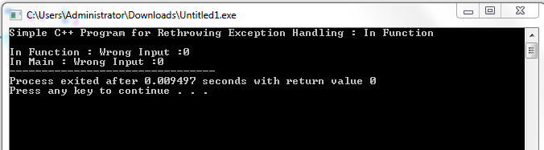

Slide 36
#include <iostream>
using namespace std;
void riskyFunction() {
throw "Something bad happened!";
}
int main() {
try {
try {
riskyFunction();
}
catch (const char* msg) {
cout << "Logging inside inner catch: " << msg << endl;
throw; // Rethrow the same exception
} }
catch (const char* msg) {
cout << "Handling exception in outer catch: " << msg << endl; }
return 0;
}

Slide 37
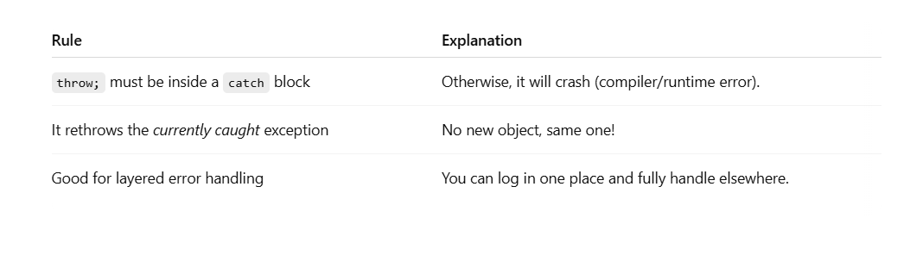

Slide 38
Output?
#include <iostream>
using namespace std;
int main() {
try {
throw "Initial exception!"; }
catch (const char* msg) {
cout << "Caught inside catch: " << msg << endl;
// Rethrow the same exception
throw;
}
// This will never be executed because the program terminates
cout << "After catch." << endl;
return 0;
}

Slide 39
#include <iostream>
using namespace std;
int main() {
try {
throw "Initial exception!"; }
catch (const char* msg) {
cout << "Caught inside catch: " << msg << endl;
// Rethrow the same exception
throw; }
catch (const char* msg) {
cout << "Caught outer catch: " << msg << endl;
}
cout << "After catch." << endl;
return 0;
}

Slide 40
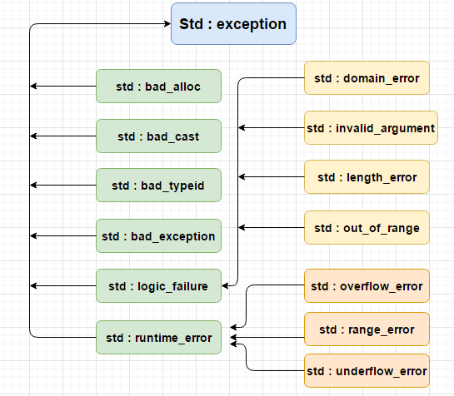
C++ Standard Exceptions

Slide 41
C++ Standard Exceptions
C++ provides a list of standard exceptions defined in <exception> which we can use in our programs

Slide 42
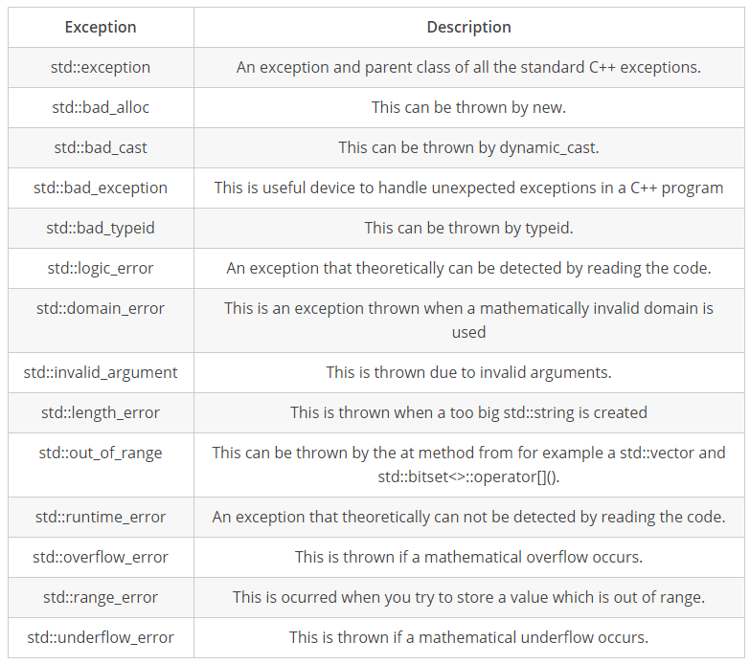
C++ Standard Exceptions

Slide 43
User-Defined Exceptions
The C++ std::exception class allows us to define objects that can be thrown as exceptions. This class has been defined in the <exception> header. The class provides us with a virtual member function named what.
This function returns a null-terminated character sequence of type char *. We can overwrite it in derived classes to have an exception description.

Slide 44
#include <iostream>
using namespace std;
class MyException {
public:
const char* what() const {
return "Something went wrong!";
}};
int main() {
try {
MyException ex;
throw ex; // Throwing an object
}
catch (MyException& e) { // Catching by reference (good practice)
cout << "Caught an exception: " << e.what() << endl;
}
return 0;
}

Slide 45
User-Defined Exceptions
#include <iostream>
#include <exception>
using namespace std;
class newException : public exception{
virtual const char* what() const throw()//We can overwrite the what() function of the exception header file to define our exceptions.
{
return "newException occurred"; }
} newex;
int main() {
try {
throw newex; }
catch (exception& ex) {
cout << ex.what() << '\n'; }
return 0; }

